Slide 1

SYSTEM ANALYSIS AND DESIGN
MIDTERM PROJECT PRESENTATION

Slide 2

ONE TEAM ONE GOAL
TEAM MEMBERS:
Yesaswini Vellaboina G02497430
Murarisetty Venkata Rahul G02496816

Slide 3


It is much easier than you think to make a difference
A SHOPPING WEBSITE TO BUY, SELL AND DONATE OLD CLOTHES,BOOKS AND TOYS

Slide 4


PROJECT DESCRIPTION
In a summary, an ecommerce website allows the users to take a look at the product catalog which gives them access to a huge range of products and the services which are offered at the best prices. The consumers can find and purchase the items without even leaving the house. This website allows the users to buy, sell or donate the unwanted products to others who are in need.
A conversational tool called chatbot which is used for the purpose of customer service, helps to solve the problems of the customers at the time of shopping.

Slide 5


Method/Approach
Using salesforce communities as the base to design the website, this includes the pagination features that are being done to implement the website.
Apex controllers are being used in order to design a customized user interface using Lightning web components, Flow builders and Aura components.
A conversational tool called chatbot is being used to communicate with the customers and solve their problems and issues during the order generation.
Conga Quote generator is being used for the purpose of generating the invoice for the orders that are placed.

Slide 6

ESTIMATED TIME LINE
To successfully complete the project, there are several key points and milestones that are to be taken into consideration.
The project implementation would take some time as there are major code fixes and implementation of the conga quote generator and the chat bot used for the generation of invoices and communicating with the customers along with the front end development using the lightning web components would be a little bit complex thing.
We predict that testing of use cases that are being developed will take some time to possibly have an error free platform.
These tasks would be finished by the second week of december (Probably before 10th december) with a proper testing of the use cases that are being developed.

Slide 7

BURN DOWN CHART
https://app.smartsheet.com/sheets/QC6mqXqMp2P8rQ35VHJ77H37 5468P4FVvq2vm5R1

Slide 8

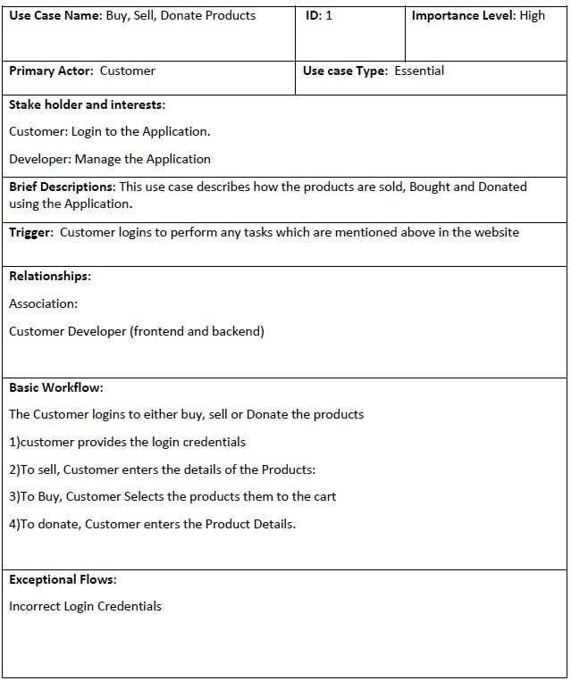
USE CASE DESCRIPTION

Slide 9
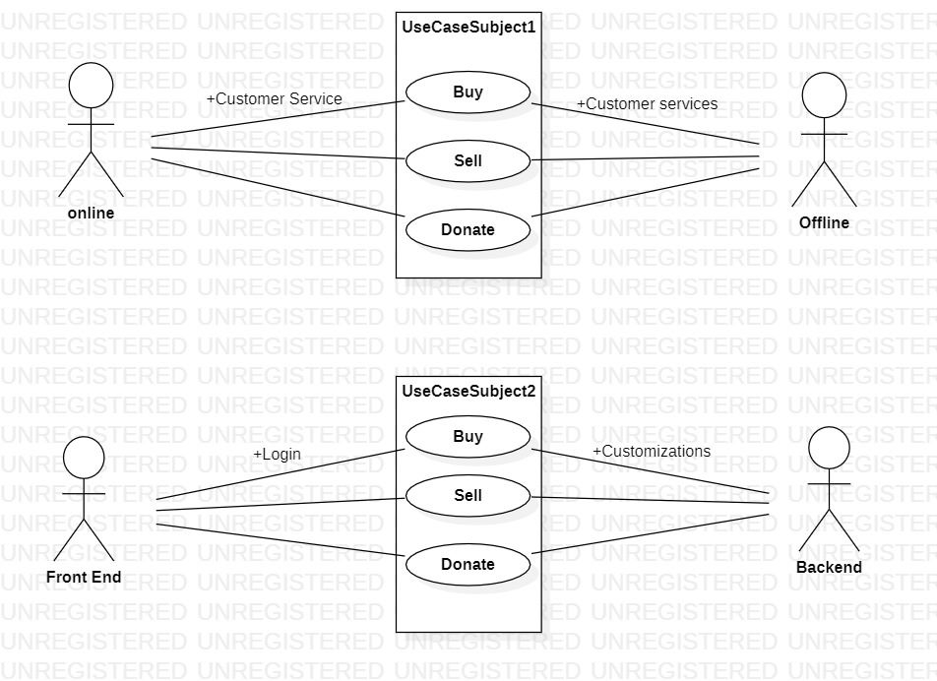
USE CASE DIAGRAM

Slide 10
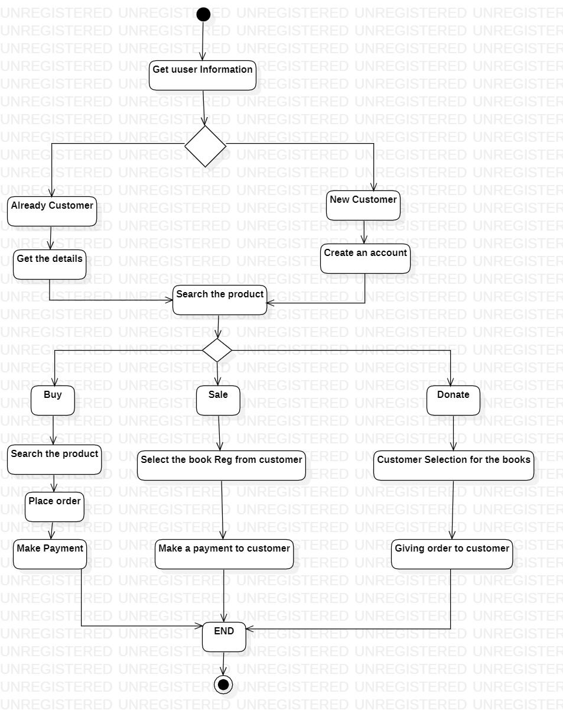
ACTIVITY DIAGRAM

Slide 11
THANK YOU

